Slide 1
Financial Management Training
Presented by:
Student Club Financial Services
Notes:
Welcome back to Financial Management Training for Registered Student Organizations. This is the second video in the training session.

Slide 2
2. Collecting Money for your RSO
Fundraising and Cash Handling Policy
Notes:
This video will be covering Fundraising and the Cash Handling Policy for student organizations at HSU.

Slide 3
Fundraising in a Virtual Setting
Practice social distancing guidelines
Do not congregate in large groups
Maintain at least 6ft between people
No in-person fundraising –Fall 2020
Alternatives to Cash Fundraisers
Online resources for fundraising
Donation mail-drives
Notes:
A lot of things will be changing this year, so let’s take a look at how fundraising will go in a virtual setting. First and foremost, you should always do your best to ensure you are upholding social distancing guidelines. This includes, not congregating in large groups and always maintaining 6 ft between people. Because of these guidelines, we cannot approve any in-person fundraising for the Fall 2020 semester. In this video we will explore alternatives to cash fundraising including online resources and donation mail-drives.

Slide 4
Asking for Donations
Solicitation
Any letters, emails, flyers, social media posts, etc. need approval
How are you representing HSU?
Send draft to giving@humboldt.edu for approval
Notes:
Your club may wish to ask for donations this upcoming semester. In any instance where you are soliciting donations, you must first have approval from the Foundation on campus. This includes donation letters, emails, social media posts or flyers. This is to ensure that your request for donations are properly representing the university. They also give some pretty great advice on how to write a letter or make it a little fancier! For approvals or assistance, please send a draft of your letter to giving@humboldt.edu. Please include a list of who you anticipate your audience to be so they can help curate your letter to appeal to the donor!

Slide 5
Donation Letter Drive
How-To
Draft a letter requesting donations
Get approval from Foundation
Pick up return envelopes from Cashiers
Send letters in mail (email, social media)
Donor mails in check or donates online
Notes:
I have included here a quick step by step guide on starting a donation drive for your organization. First you must draft your letter. Consider who your audience is and ways to make it personable. Second, you can send your draft to giving@humboldt.edu and await approval from the Foundation. Once it is approved, you can pick up return envelopes from the Cashier’s office. This ensures that if your donor wants to mail in a check, it comes right to the cashier’s and gets deposited to your account. Next, you will send out your solicitation to your donors. It might be a good idea to follow up with a phone call to let them know that your donation letter is on the way! Lastly, the donor can either mail in their donation with the return envelope, or donate online directly to your organization’s giving page!

Slide 6
Types of Virtual Fundraising
Online Resources
RSO CashNet Store
Online Donations
Crowdfunding
CustomInk Fundraiser
Notes:
If snail mail’s not your gig, we also have a number of other virtual fundraising methods for your organization to use.

Slide 7
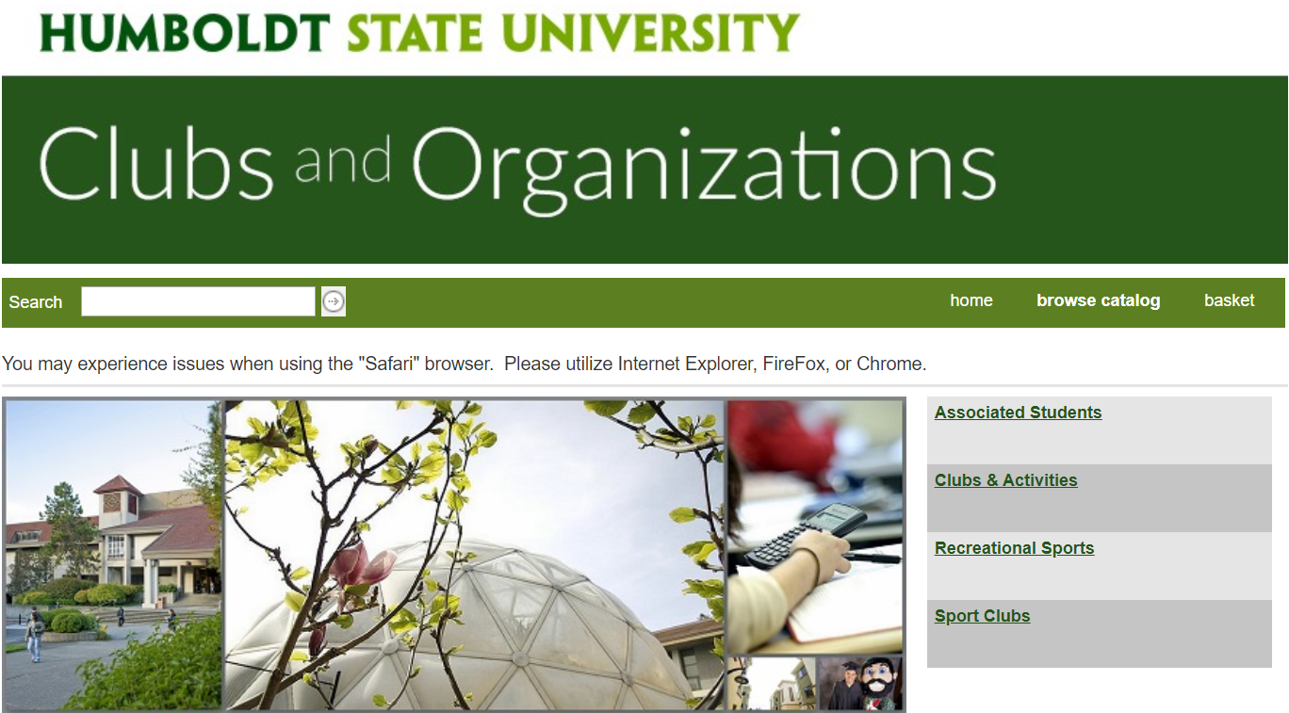
RSO Online Payment Portal
CashNet for RSO payments/sales
Dues, Presale Tickets, Deposits, Merchandise
No Credit Card fees
Recurring reports to RSO humboldt.edu email
Personalized receipts
Notes:
First up, we have the RSO Online Payment Portal. This payment portal is operated through CashNet and can be customized for all kinds of organization payments. This can range from collecting dues from your members, pre-selling tickets, making deposits, or selling your organization’s merchandise.
There no fees to get started, AND there are no credit card fees for your customers either! Once we have your store set up, you have the option to get customized reports sent to your organization’s Humboldt email so that you can track your sales. You can also provide personalized receipt text for your customers. This can include information for members paying their dues, or instructions for your customers to pick up their order.

Slide 8
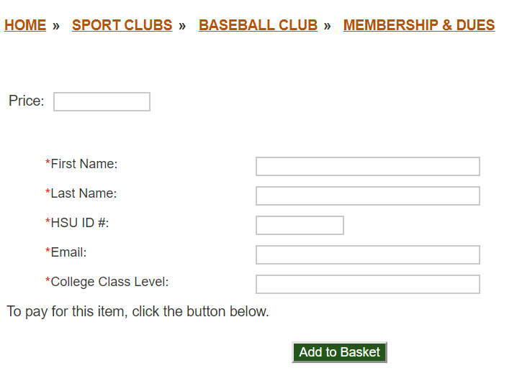
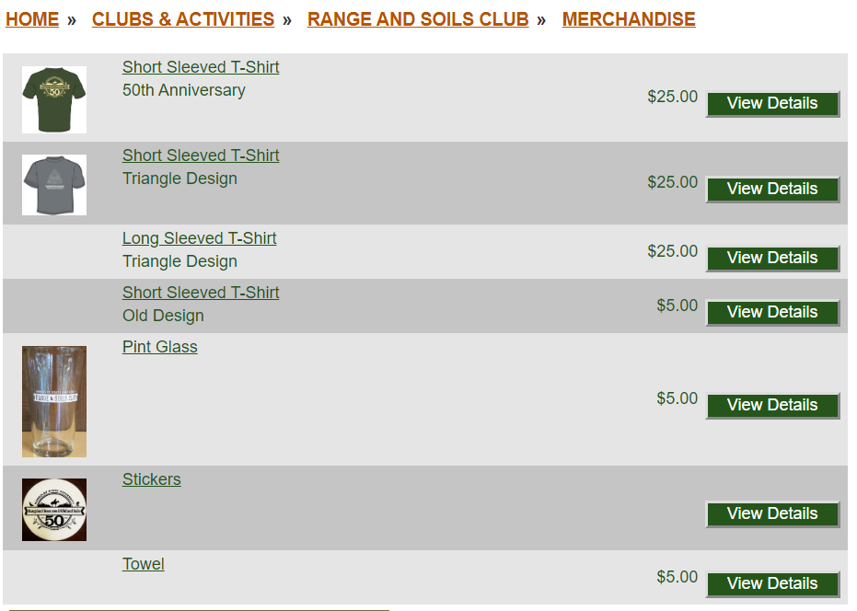
Pay Dues
Sell Merchandise
Notes:
Here are some examples of what the CashNet store can look like. This organization collects specific information from their members when they pay their dues. This club has been set up to sell their merchandise. You can even include a picture so your customers know what they are buying. To get your organization’s CashNet store started, please contact the Club Financial Coordinator.

Slide 9
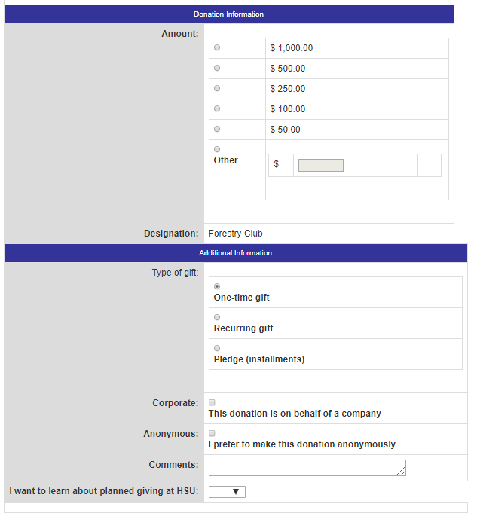
Giving Page
Used for credit card donations
Include a link to your giving page on your org’s social media
Most RSO’s already established
Contact us to get your page!
Notes:
Next, you can have people donate online directly to your organization with the online giving page. This page is for those who wish to donate with a credit card. Once your page is set up, you can save the link, and post it to your organization’s social media, and get the word out!
Most student organizations have already been set up in the system to receive donations. If you are part of a new organization, or are not sure if you have one, feel free to contact the Club Financial Coordinator to help get your page up and running.

Slide 10
Crowdfunding
Used for specific goal
Raise money for equipment, hosting a virtual seminar
Future events/travel – post COVID
Funds cannot be raised for any specific individual
Notes:
If your organization has a big expense coming up, you may also consider Crowdfunding. HSU has their own crowdfunding software that student organizations can utilize. Crowdfunding is used for a specific goal, such as purchasing a large piece of equipment or raising money to host a virtual seminar with a well-known guest speaker. Outside of the virtual campus scenario, crowdfunding is an excellent way to raise money for large events, or help send your members to a conference. It is important to know that a crowdfunding campaign must benefit your organization as a whole, so keep in mind that crowdfunding cannot be used to benefit any specific individual.
Having a set goal in mind with a specific timeframe can help give your donors a sense of urgency, and show that their donation really matters. In the example given here, the PC Gaming Club raised over $2000 to install a flight simulator. When campus opens up again, go check it out on the 3rd floor of the library! For questions on getting your crowdfunding campaign set up, please contact the Club Financial Coordinator.

Slide 11
CustomInk
HSU’s only Third-Party partner for online fundraising
No cost to get started
Choose from a variety of custom products
Orders shipped for you
Notes:
Lastly, we have one more way to virtually fundraise with CustomInk. CustomInk is the only 3rd party vendor that has been approved to collect money and fundraise on behalf of HSU’s student organizations. The great part is that there are absolutely no costs to get started. You can choose from a variety of merchandise options on their website, and CustomInk will fulfill your order for you.

Slide 12
CustomInk Fundraiser
3. Set goal and meet the minimum to print
1. Design your shirt
2. Set your price
4. Profit! $$$
Notes:
Let’s take a quick look on getting started. On their website, you will select the items you wish to sell, like t-shirts, hats, sweaters, or waterbottles. Next, you will upload your organization’s logo that will be displayed on the merch. You will then set the price that you want to tell them at. Remember, since you do not have to pay to use this service, CustomInk takes a cut of the profit to sustain their operations. Because of this, you will have to meet the minimum goal of items to sell. CustomInk will tell you how many you need and the amount can change based on the price of your items. At the bottom, you will be prompted on the potential earnings if you reach your goal. Once the campaign is up and running, you can send your customers a link to purchase the item.
CustomInk has shirt sizes ranging from Youth extra small to quadruple extra-large! This method of fundraising is great since you don’t need to guess how many shirts to buy upfront and then get disappointed when all you have left are double extra larges left. CustomInk will then fulfill your order and mail the merch to your customer and the check gets sent to Campus to be deposited directly to your organization’s account. There are a few last steps to get your campaign set up, so please contact the club financial coordinator if you wish to utilize this service.

Slide 13
What if I have cash? (Making Deposits)
Deposit within 24 hours or next business day – to campus account
Do NOT hold money longer than 1 week!
Cashier’s Office – SBS 2nd Floor
Get a receipt for your deposit
(Tues & Thurs; 10am – 3pm)
University Police Department – SBS 1st Floor
Include org name, account # and deposit slip
Dropbox (24/7) – call to enter building
Notes:
While we have all of these amazing services to get your organization virtually fundraise, there may be the rare circumstance where you happen to collect cash. While cash fundraisers are not approved this semester, we still want to inform you on the proper cash handling protocol if it happens. Please remember that cash should be deposited promptly to the cashier’s office within 24 hours of receiving the cash. If that is not possible, do not hold it for any longer than 1 week.
You can make deposits directly at the cashier’s office in SBS on the 2nd floor. If you choose to do so, you can get a receipt then and there for your deposit. Please keep in mind that the cashier’s office will have limited hours on campus to ensure social distancing guidelines are upheld.
If you are not able to come to the cashier’s office during their open hours, you can also utilize the University Police Department Dropbox. This dropbox is located just outside of the UPD window. Their office is open 24 hours a day, 7 days a week. You may need to call to have them let you into the building if it is outside of normal operating hours. Please be sure to put your deposit in a sealed envelope, with your organization’s name, account number and include a deposit slip so we know what the deposit was for.

Slide 14
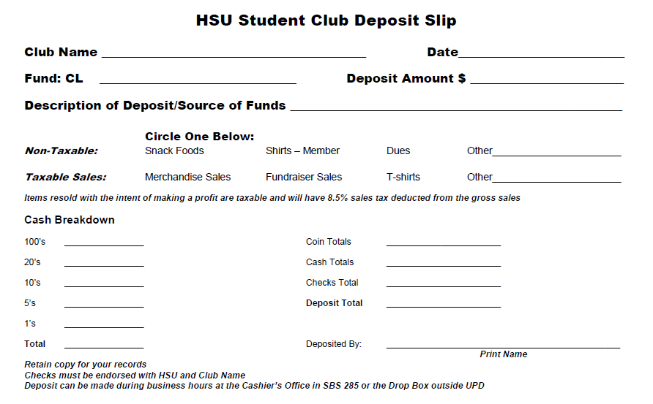
My Org Name
1/19/2020
###
$75
T-Shirt Sale
1
$50
1
$25
4
$75
Gina Yap
Notes:
Let’s take a look at what the deposit slip looks like and how to fill it out. You can find a copy of this deposit slip online at the Club Financial Services Website. At the top of the slip, you will fill out the information for your organization. This is to make sure it gets deposited to the right account! You will then provide a description of the funds. This description will appear on your CashNet report, so make sure it is relevant. Next, you will provide a breakdown of the money you are depositing. In this scenario, I collected $50 in cash and $25 as a check for my organization’s t-shirt sale, totaling $75. Please keep in mind that certain types of deposits are subject to sales tax, such as most merchandise or food sales. If you are not sure which category to put, feel free to contact the club financial coordinator for more help.

Slide 15
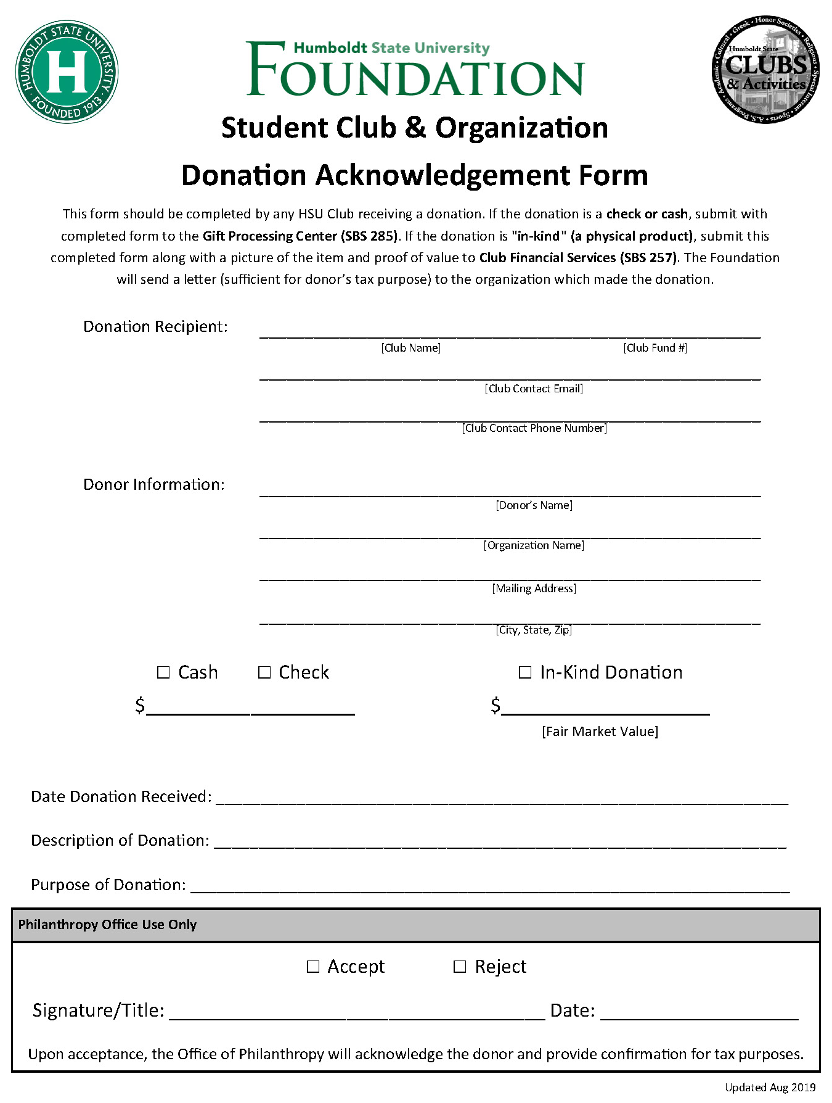
Donation Acknowledgement
What is a Donation?
Money/Items given – no strings attached!
Used for accepting large cash/check donation or donated goods (In-Kind)
Donor gets a tax receipt
Template available for letter drives
Notes:
If the money you are depositing also happens to be a donation, or you get an item donated to your organization, we require you to also submit a donation acknowledgement form. This acknowledgement form will ensure that your donor gets a tax receipt from Humboldt State for their donation. The donation tax receipt is a huge benefit for donors since they can write it off on their annual tax filing. While this process is done automatically with online donations, we don’t want them to miss out on getting their tax receipt for cash or check donations. If you are collecting money from a donation mail drive, there a smaller condensed version of this form that you can include on the bottom of your letter for your donor to fill out when they send their check in.

Slide 16
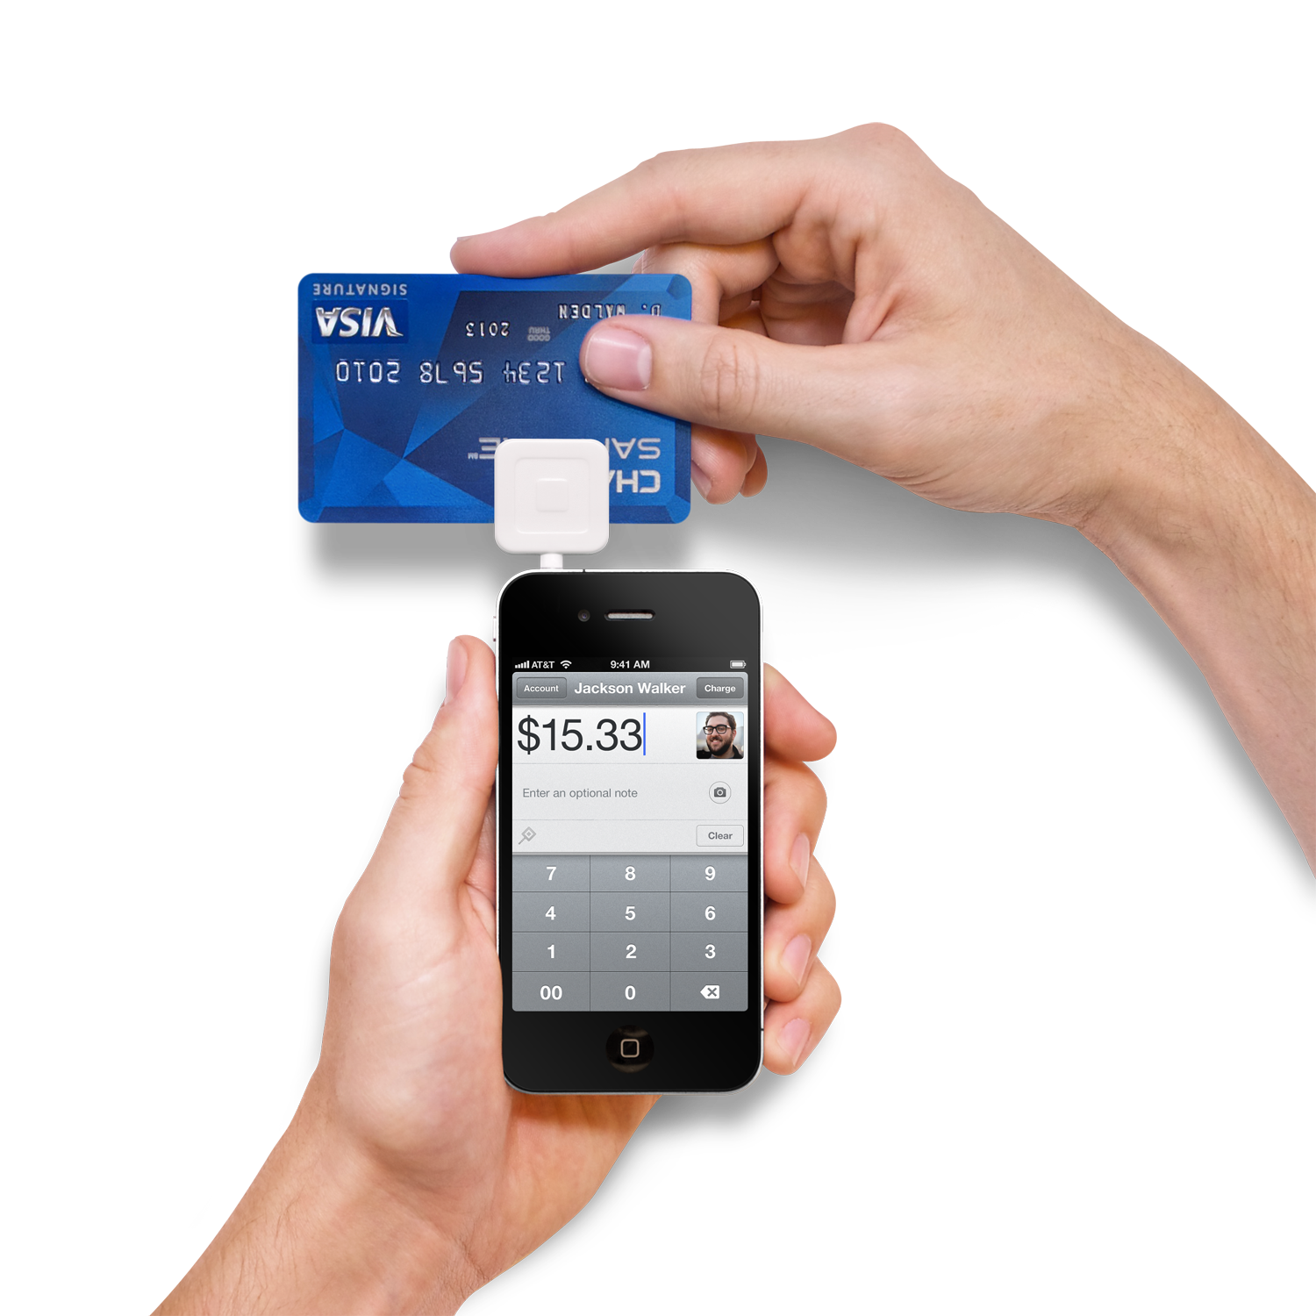
Management of Money (Cash & Cash Equivalents)
Dual custody of money
Keep physical records of any transaction - receipts
Keep money in a locking cash box
Only accept checks from a reputable source
No use of Third-Party money collection
Ex: Venmo, PayPal, Eventbrite, GoFundMe, etc.
Notes:
As always we encourage you to follow best business practices when handling cash or cash equivalents and make smart decisions with your money. This includes always handling money in dual custody – at least 2 members at a time. You should also keep physical records of any transaction such as receipts to or from the customer. Money that you happen across should be stored in a locking cash box with minimum access if you are not able to deposit it right away. If you do end up accepting a check, make sure it comes from a reputable source. This means that you trust the person giving you the check is not writing a bad check, and that you know where to find them if anything should happen regarding their payment. Checks that are bounced incur a $25 dishonored check fee to the organization accepting the payments. In most instances, this fee can be passed back to the customer who wrote the bad check so it is important you know how to get a hold of them. Lastly, it is imperative to know that HSU student organiztions are not allowed to use any third party money collection sites such as venmo, square, paypal, Eventbrite for ticketing or gofundme for crowdfunding.

Slide 17
“Why can’t my org use Third-Party Payment sites?” (Venmo/Square/PayPal/EventBrite/GoFundMe/Etc)
PCI Compliance
Standards of cyber security for online payments
Financial Oversight
Tax Obligations
On-Campus resources available
Notes:
Given the widespread use of these platforms, you may wonder why your organization is not allowed to use these sites. There are a number of reasons. First, these sites do not meet HSU’s standard for PCI Compliance. PCI Compliance is a regulation of data integrity for sensitive information handling. HSU handles a lot of sensitive data such as your student information, so our standard is very high to ensure the safety of your information. Unfortunately, these sites do not meet HSU’s high standards which means they may be more at risk of hacking or tampering.
In addition, these platforms do not give your organization much oversight on how your money is being handled, and often charge fees to use them. There have been instances at HSU and other California State campuses where a third party collection site, venmo, was utilized by a single person in an organization, only to later find that the money never made it back to the organization. While we want to trust our fellow members, lowering the opportunity to take advantage of a situation can ensure incidents like that do not happen again.
Humboldt State University is obligated to report all financial activity in their tax filings, including the financial activity of student organizations. If a third party site is utilized by a student organization, HSU will then be reporting false financial information which could put the standing of the student organizations at risk. And as always, we have a number of online virtual resources available that can be utilized, just be sure to reach out to our office ahead of time to ensure everything is running smoothly.

Slide 18
Where can you find online resources for fundraising?
studentfinancialservices. humboldt.edu /club-financial-services
Notes:
You can find links to these services online on our website here. Club Financial Services is housed under Student Financial Services. And as always, you can reach out to your friendly neighborhood club financial coordinator to help with any questions you may have in getting your fundraising up and running!

Slide 19
Review
Remember social distancing guidelines – No cash fundraising at this time
Deposits made at the Cashier’s Office within 24hrs, but no longer than 1 week
Various online resources for virtual fundraising
Acknowledge & thank your donors for supporting your organization
Notes:
Let’s review some key points from this training:
First, always keep social distancing practices in mind. We all should be doing our part to slow the spread of the coronavirus. Unfortunately, this means we cannot approve any cash fundraisers at this time.
Next, you learned what to do if you happen to collect any money and where to make your deposits at the cashier’s office or UPD. Just be sure to not hold it any longer than 1 week
You also learned about various ways to host virtual fundraisers! Hopefully, you even got some new ideas!
Lastly, we learned the importance of acknowledging and thanking your donors for supporting your organization. Doing so makes them more likely to keep giving to your organization.
Thank you for completing this training video. We will see you again in the last video!

Slide 20
Financial Management Training
Presented by:
Student Club Financial Services
Notes:
Welcome back to financial management Training for Registered Student Organizations. This is the third and final video in the training session.

Slide 21
3. Using Your RSO’s Money
Steps to utilizing your organization’s funds
Notes:
This video will be covering the process to access and use your organization’s money that you raised.

Slide 22
“What can organization money be spent on?”
Traditional Campus – Almost anything!
Fundraised money only – no grants
Virtual Campus – Fall 2020
Adhere to social distancing guidelines
No purchases for group events
Notes:
First, we need to address what your organization’s money can be spent on. In the traditional process, your organization’s money could be used for almost anything with few restrictions. Please note that this only applies for money that your organization fundraised, but not other revenue sources such as Associated Student Grants. Now, with campus operations moving virtually, there will be a few more restrictions in place, in order to adhere to social distancing guidelines. In general purchases for large events or group gatherings will not be approved for purchase from your organization’s trust fund account.

Slide 23
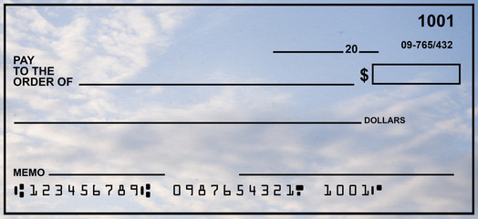
Direct Payments
For Services & Supplies
To Guest Speakers
Purchase online with ProCard! (recommended)
Provide link to purchase
Provide itemized invoice
Or check sent in the mail
Provide flyer for speaker event
Notify our office before the event so we can send paperwork to get guest paid!
Cannot reimburse travel expenses/hospitality at this time
Notes:
There are a few ways to access the funds in your organization’s on-campus trust account. The first way is through direct payments. It is recommended that payments be made from the account by utilizing the Club Financial Coordinator’s ProCard. It is a lot quicker and easier to get payments made for your supplies or services this way. You will just need to send me a link to the item you wish to purchase or provide an invoice, and I will shop and pay it directly for you. Alternatively, if a company of business cannot accept card payments, we can send a check in the mail. This method takes a bit longer and requires some more paperwork to process.
Payments can also be made directly to guest speakers or guest lecturers, if you wish to invite them for a Zoom or virtual performance. You would just need to provide a copy of the flyer advertising the guest speaker’s event as proof of their participation. Once you know your organization will be inviting a guest speaker, please contact Club Financial Services ahead of time so that we can get the necessary paperwork started to get your guest paid. Unfortunately, at this time, we cannot reimburse your guest speaker for any travel or hospitality expenses, since non-essential travel cannot be approved or endorsed by the university in an effort to slow the spread of the coronavirus. When you consider making purchases on behalf of your organization, please start with the option to pay businesses or vendors directly, so that you, or your members, do not have to pay out of pocket.

Slide 24
Where can the ProCard be used?
Notes:
Taking advantage of the ProCard is the recommended way to make purchases from your organization’s account, but you may wonder where it can be used. Here are a few examples of websites that can accept the procard. Humboldt State University has special business accounts with Amazon and Staples, so we typically can get products at a cheaper rate. These savings are available for Registered Student Organizations as well! As a general rule, if you can order something online, we can pay for it online as well. Please keep this option in mind as we progress through this semester, virtually.

Slide 25
Reimbursements
To Organization Members/Advisor
Used when not convenient to pay online with Card or with Check
Takes up to 10 business days to process – checks will be mailed
Needs itemized receipts
No Drugs, Alcohol or Tobacco!
Cannot reimburse travel expenses at this time
Notes:
The next type of payments from the on-campus account are reimbursements. Reimbursements should only be used if it not convenient to pay online with a procard, or send a check in the mail. Examples of this might include purchasing small items at a grocery store. As a general rule, reimbursements should only be used if it does not incur a personal financial burden to any individual. A reimbursement should typically be less than $50. Reimbursements can take up to 10 business days to process, and will also take additional time to be mailed. To enforce social distancing guidelines, we will not be offering cash reimbursements, or check pick-up this semester. If you need to get reimbursed from your account, please be sure to save your original itemized receipts. Receipts that are missing essential information are not suitable to be reimbursed. One of the main restrictions around accessing your organization’s money, is that you cannot purchase or be reimbursed for drugs, alcohol, or tobacco products. In addition, we will not be able to reimburse for travel expenses as most student organization travel is deemed non-essential.

Slide 26
RSO Payment Request Form
Form found on Lumberjack Link
Officers must complete training before making purchases!
Money spent for org purposes
Pay directly from the account without spending your own money!
Notes:
To complete any of these type of payments from your organization’s account, you will need to submit a Payment Request Form for Student Organizations. This form can be found online on our website. Before your Payment Request can be accepted, it is important that the organization’s president, treasurer, and advisor complete this financial training, and submit the financial agreement. If your organization changes president, treasurer, or advisor during the school year, they must complete the financial training, and sign the financial agreement before they are able to sign for a payment request. As a general rule, please be sure that money spent from your organization’s account is used for the benefit of your organization as a whole. Payments cannot be used to benefit any single individual. Utilizing the payment request correctly can be a great way to pay for things directly from your account without having to spend your own personal money.

Slide 27
RSO Lost Receipt Memo
Needed if receipt/invoice cannot be found or replaced – missing info
Provide explanation for missing receipt
Signatures from recipient, advisor & President/Treasurer
Submit with Payment Request Form
Notes:
It may happen sometimes that you need a reimbursement and your receipt becomes lost or is missing essential information. You should always try your best to recover any lost receipts by returning to your vendor and ask to re-print the receipt. If all efforts to recover the lost receipt or invoice have been exhausted, you are not out of luck! You may turn in a Lost Receipt Memo in lieu of your missing backup. This form ensures that a reimbursements can still be made form your organization’s account. You must include information that would have appeared on the receipt, and a brief explanation as to why the receipt is missing. This form must be signed by the recipient of the reimbursement, the president or treasurer, and the advisor. This form is submitted with the payment request form and should only be used as a last attempt to get reimbursed.

Slide 28
Steps to use the Payment Request Form
1. Get Receipts or Invoice
2. Fill out Payment Request Form
3. Obtain Signatures from Pres/Tres & Advisor
4. Attach necessary backup to Payment Request Form
5. Submit to Club Financial Coordinator for approval
Needs Additional Paperwork!
Reimbursement Check Sent in the Mail
Pay online with ProCard
Check Sent in the Mail to Vendor
Notes:
To help you visualize the process of the payment request, I have outlined the steps involved. First, you will obtain your receipts or invoice. Then, you must fill out the appropriate sections of the payment request form. Next, you will ensure that the form is approved by either the president or treasurer, and also the advisor. All payment request must have 2 signatures: one from a student officer, and one from the advisor. Next, please be sure to include any applicable backup to your request that justifies the payment, such as receipts, invoices, a guest speaker flyer, or a lost receipt memo. Lastly you will turn them in to the Club Financial Coordinator for final approval. Once your payment request is submitted, one of 3 outcomes will occur based on the nature of the request. You may have a check sent in the mail to a member for a reimbursement, The Club Financial Coorindator can pay online with a procard, or a check in sent in the mail to the business, vendor or guest speaker. Just remember, that with this last option, additional paperwork is required from the vendor to get a check written. We can assist you in getting this paperwork filed and reach out to the vendor if they are not already in our financial system.

Slide 29
Review
Most payments from the org account can be made directly to vendors
Club Financial Coordinator can help you purchase things online with the Procard
No reimbursements for travel or group events at this time
Make sure to keep your receipts if you need a reimbursement
Notes:
You have learned a lot about the different types of ways to utilize your organization’s on-campus account. Let’s take some time to review the key points:
First, you learned how payments can be made from your organization’s account directly to businesses or vendors you work with.
Next you learned about how to best utilize the Club Financial Coordinator’s ProCard to make online purchases
You have also been informed of new restrictions due to the COVID-19 pandemic including the fact that we cannot reimburse, or make payment for travel or group events
Also you were reminded to hold onto your receipts if you need a reimbursement, and what alternative is available if your receipt ends up lost, or missing information.
Thank you for completing this training video. This is the final video in the Financial management training series. Once you finish watching this video, you will take a short quiz to test your knowledge. After submitting your quiz, your responses will be reviewed and if you pass, you will have access to sign the Financial Agreement. Please feel free to refer back to these videos when taking the quiz, or for a refresher at any point in the future. Thank you, and have a wonderful semester at Humboldt State University.

